Slide 1

Training Neural Networks
Presented by:
Elizer Ponio Jr.
Department of Computer Science
College of Computing and Information Technologies

Slide 2
Outline
What is Back Propagation?
Back Propagation Example

Slide 3
Backpropagation

Slide 4

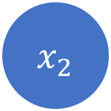

$${ x}_{1}$$
Activation function
$$\hat{p}$$
Activation function
Loss function
$${ x}_{2}$$
Activation function
Calculate Loss
Input Layer
Hidden Layer
Output Layer
FORWARD PASS (MAKE PREDICTION)

Slide 5

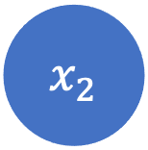
$${ x}_{1}$$
Activation function
$$\hat{p}$$
Activation function
Loss function
$${ x}_{2}$$
Activation function
Calculate Loss
Input Layer
Hidden Layer
Output Layer
BACK PROPAGATION (Adjust all weights to reduce loss)

Slide 6
Back Propagation Example

Slide 7

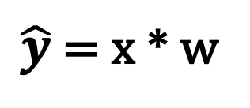
x
$$\hat{y}$$
w
$\hat{y}$ = x * w
Input Layer
Output Layer

Slide 8
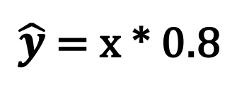
x
Let us initialize weight (w) to 0.8
$$\hat{y}$$
w = 0.8
$\hat{y}$ = x * 0.8
Input Layer
Output Layer

Slide 9
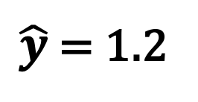
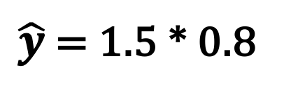
Input (x) | Actual Output (y)
1.5 | 0.5
x
$$\hat{y}$$
w = 0.8
$\hat{y}$ = 1.5 * 0.8
$\hat{y}$ = 1.2
Input Layer
Output Layer

Slide 10
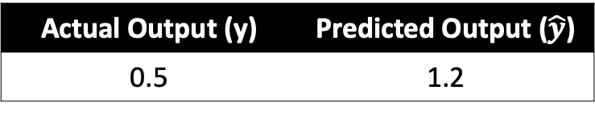
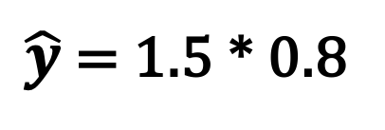
Input (x) | Actual Output (y)
1.5 | 0.5
x
$$\hat{y}$$
w = 0.8
$\hat{y}$ = 1.5 * 0.8
$\hat{y}$ = 1.2
Actual Output (y) | Predicted Output ($\hat{y}$)
0.5 | 1.2
Input Layer
Output Layer

Slide 11
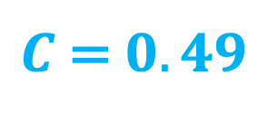
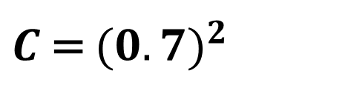
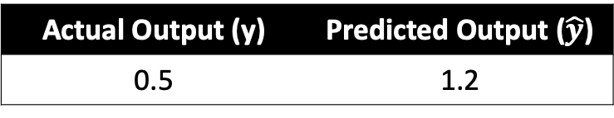
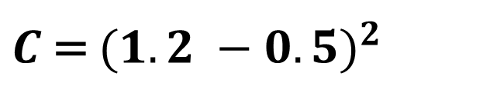
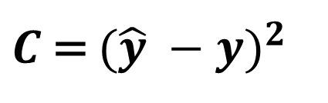
Let us use Mean Squared Error (MSE) as our cost function (C)
Actual Output (y) | Predicted Output ($\hat{y}$)
0.5 | 1.2
x
$$\hat{y}$$
w = 0.8
$C$ = ${(\hat{y} −y)}^{2}$
$C$ = ${(1.2 −0.5)}^{2}$
$C$ = ${(0.7)}^{2}$
$C$ = $0.49$
Input Layer
Output Layer

Slide 12

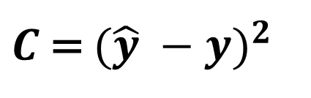
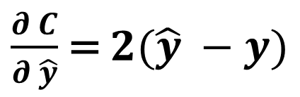
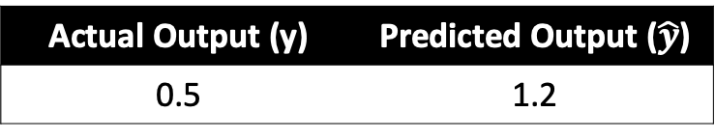
x
$$\hat{y}$$
w = 0.8
Actual Output (y)
Input Layer
Output Layer
Actual Output (y) | Predicted Output ($\hat{y}$)
0.5 | 1.2
$C$ = ${(\hat{y} −y)}^{2}$
Weight
$\frac{∂ C}{∂ \hat{y}}$ = $2(\hat{y} −y)$

Slide 13
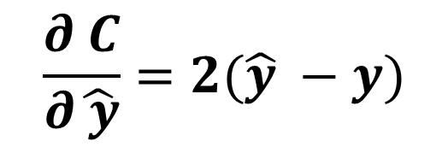
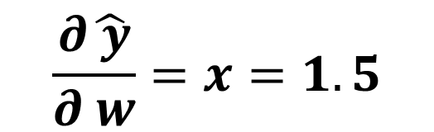
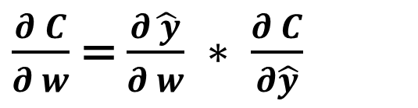
x
$$\hat{y}$$
w = 0.8
Actual Output (y)
Input Layer
Output Layer
$\frac{∂ C}{∂ w}$ = $\frac{∂\hat{ y}}{∂ w} ∗ \frac{∂ C}{∂\hat{y}}$
$$\frac{∂\hat{ y}}{∂ w}=x=1.5$$
Weight
$$\frac{∂ C}{∂\hat{ y}}=2(\hat{y} −y)$$

Slide 14
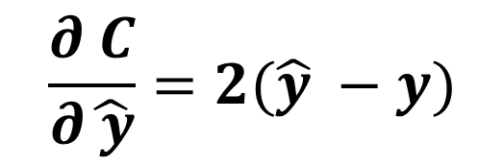

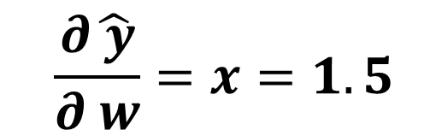


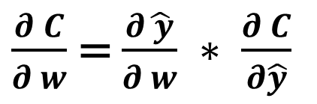
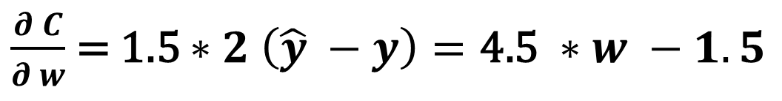




x
$$\hat{y}$$
w = 0.8
Actual Output (y)
Input Layer
Output Layer
$\frac{∂ C}{∂ w}$ = $\frac{∂\hat{ y}}{∂ w} ∗ \frac{∂ C}{∂\hat{y}}$
$$\frac{∂\hat{ y}}{∂ w}=x=1.5$$
$$\frac{∂ C}{∂\hat{ y}}=2(\hat{y} −y)$$
Weight
$\frac{∂ C}{∂ w}$ = 1.5 $∗2 \left(\hat{y} −y\right)=\text{4.5 }∗w −1.5$

Slide 15
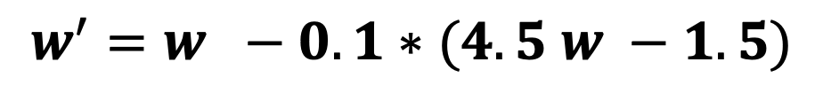
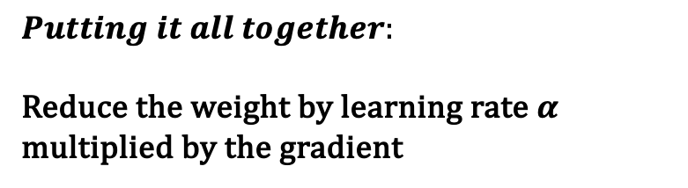
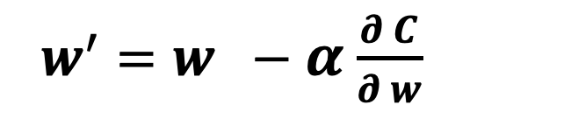
x
$$\hat{y}$$
w = 0.8
Actual Output (y)
Input Layer
Output Layer
$$Putting it all together:$$
Reduce the weight by learning rate $α$ multiplied by the gradient
Weight
$w^{′}=w −α$ $\frac{∂ C}{∂ w}$
$$w^{′}=w −0.1∗(4.5 w −1.5)$$

Slide 16
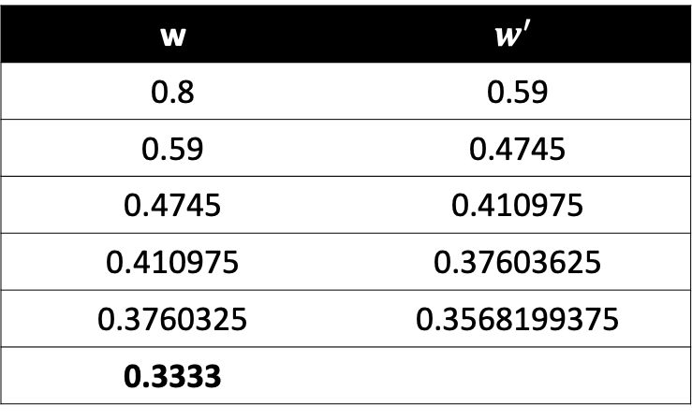
x
$$\hat{y}$$
w = 0.8
Actual Output (y)
Input Layer
Output Layer
w | $$w^{′}$$
0.8 | 0.59
0.59 | 0.4745
0.4745 | 0.410975
0.410975 | 0.37603625
0.3760325 | 0.3568199375
0.3333
Weight

Slide 17

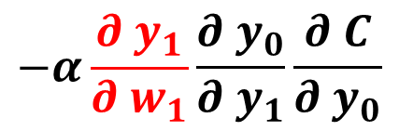


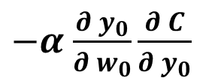



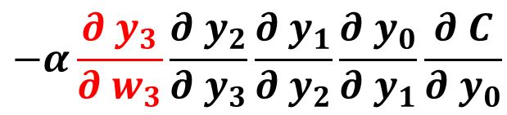



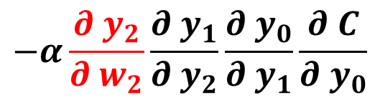
$$y_{4}$$
$y_{3}=w_{3} ∗y_{4}$
$y_{2}=w_{2} ∗y_{3}$
$y_{1}=w_{1} ∗y_{2}$
$y_{0}=w_{0} ∗y_{1}$
$$w_{3}$$
$$w_{2}$$
$$w_{1}$$
$$w_{0}$$
$−α$ $\frac{∂{ y}_{0}}{∂{ w}_{0}}\frac{∂ C}{∂{ y}_{0}}$
$$−α\frac{∂{ y}_{1}}{∂{ w}_{1}}\frac{∂{ y}_{0}}{∂{ y}_{1}}\frac{∂ C}{∂{ y}_{0}}$$
$$−α\frac{∂{ y}_{2}}{∂{ w}_{2}}\frac{∂{ y}_{1}}{∂{ y}_{2}}\frac{∂{ y}_{0}}{∂{ y}_{1}}\frac{∂ C}{∂{ y}_{0}}$$
$$−α\frac{∂{ y}_{3}}{∂{ w}_{3}}\frac{∂{ y}_{2}}{∂{ y}_{3}}\frac{∂{ y}_{1}}{∂{ y}_{2}}\frac{∂{ y}_{0}}{∂{ y}_{1}}\frac{∂ C}{∂{ y}_{0}}$$

Slide 18

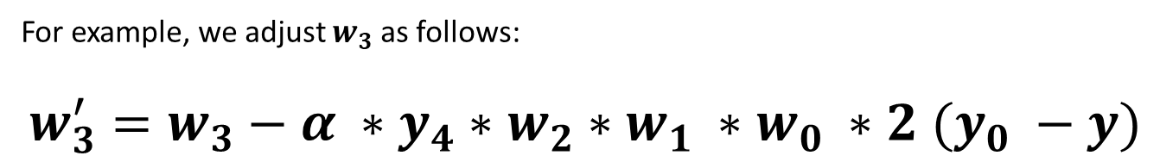
$$y_{4}$$
$y_{3}=w_{3} ∗y_{4}$
$y_{2}=w_{2} ∗y_{3}$
$y_{1}=w_{1} ∗y_{2}$
$y_{0}=w_{0} ∗y_{1}$
$$w_{3}$$
$$w_{2}$$
$$w_{1}$$
$$w_{0}$$
For example, we adjust $w_{3}$ as follows:
$w_{3}^{′}=w_{3}−α ∗y_{4}∗w_{2}∗w_{1} ∗w_{0} ∗2 (y_{0} −y)$
$$−α\frac{∂{ y}_{3}}{∂{ w}_{3}}\frac{∂{ y}_{2}}{∂{ y}_{3}}\frac{∂{ y}_{1}}{∂{ y}_{2}}\frac{∂{ y}_{0}}{∂{ y}_{1}}\frac{∂ C}{∂{ y}_{0}}$$

